Slide 1
Build an End-to-End AWS Web Application -Power OF MATH using aws services
MAJOR Project -AWS

Slide 2
Introduction:
In today’s digital landscape, building web applications has become a necessity for businesses and individuals alike. AWS (Amazon Web Services) offers a suite of powerful cloud services that can simplify and streamline the development process. In this blog, we will explore how to build a basic web application using AWS services such as AWS Amplify, Amazon API Gateway, AWS Lambda, Amazon DynamoDB, and AWS Identity and Access Management (IAM). Let’s dive in and discover how these services can work together to create a scalable web application. In this project, you will create a simple web application. You will first build a static web app that renders “The Power of Math!.” Then you will learn how to add functionality to the web app so that when you input two numbers i.e. base and exponent it displays result on the custom input you provide.

Slide 3
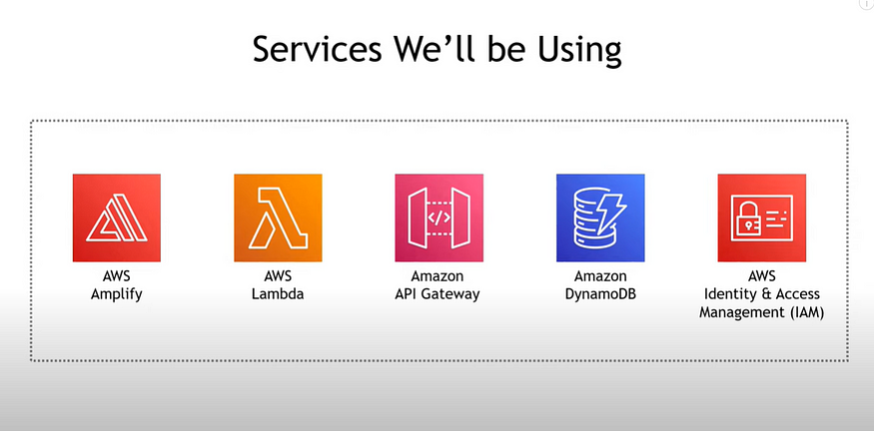
Things we will accomplish:
This Project we will go through the steps to create the sample web application discussed above. we will:
Create a web app
Connect the web app to a serverless backend
Add interactivity to your web app with an API and a database

Slide 4
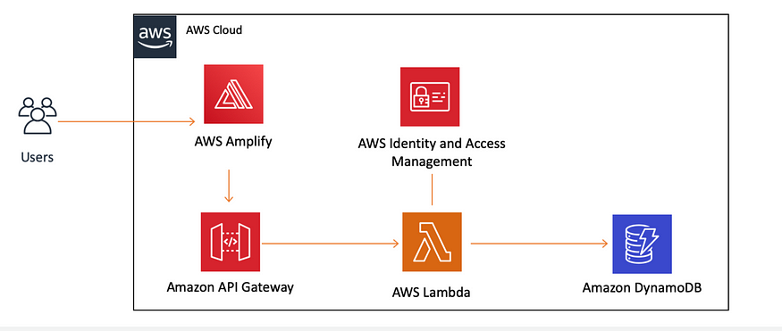
Application architecture:
The diagram below provides a visual representation of the services used in this project and how they are connected. This application uses AWS Amplify, Amazon API Gateway, AWS Lambda, Amazon DynamoDB, and AWS Identity and Access Management (IAM).

Slide 5
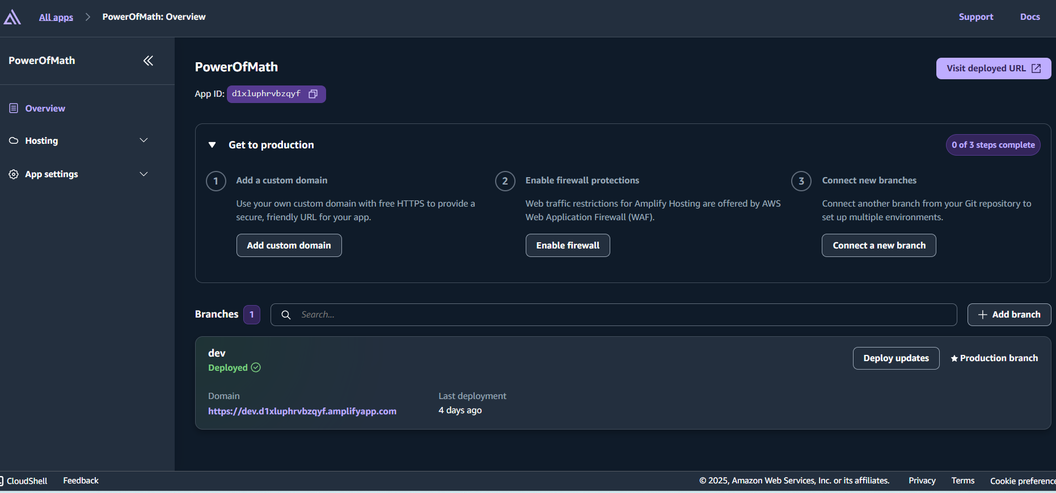
step 1 : Setting up AWS Amplify to host and deploy a static website.
Deploying and Hosting with AWS Amplify AWS Amplify is a service that simplifies the deployment of web applications. We’ll use it to host our HTML page, making our application accessible on the internet..
Create zip file for that file “index.html”, so you’ll have index.zip
You will be to this page, fill the name and name then upload the zip file “index.zip”
Your app will deployed in a moment, you can check it by clicking on the link https://dev…
Now, we just finished the first step and we got this architecture.

Slide 6
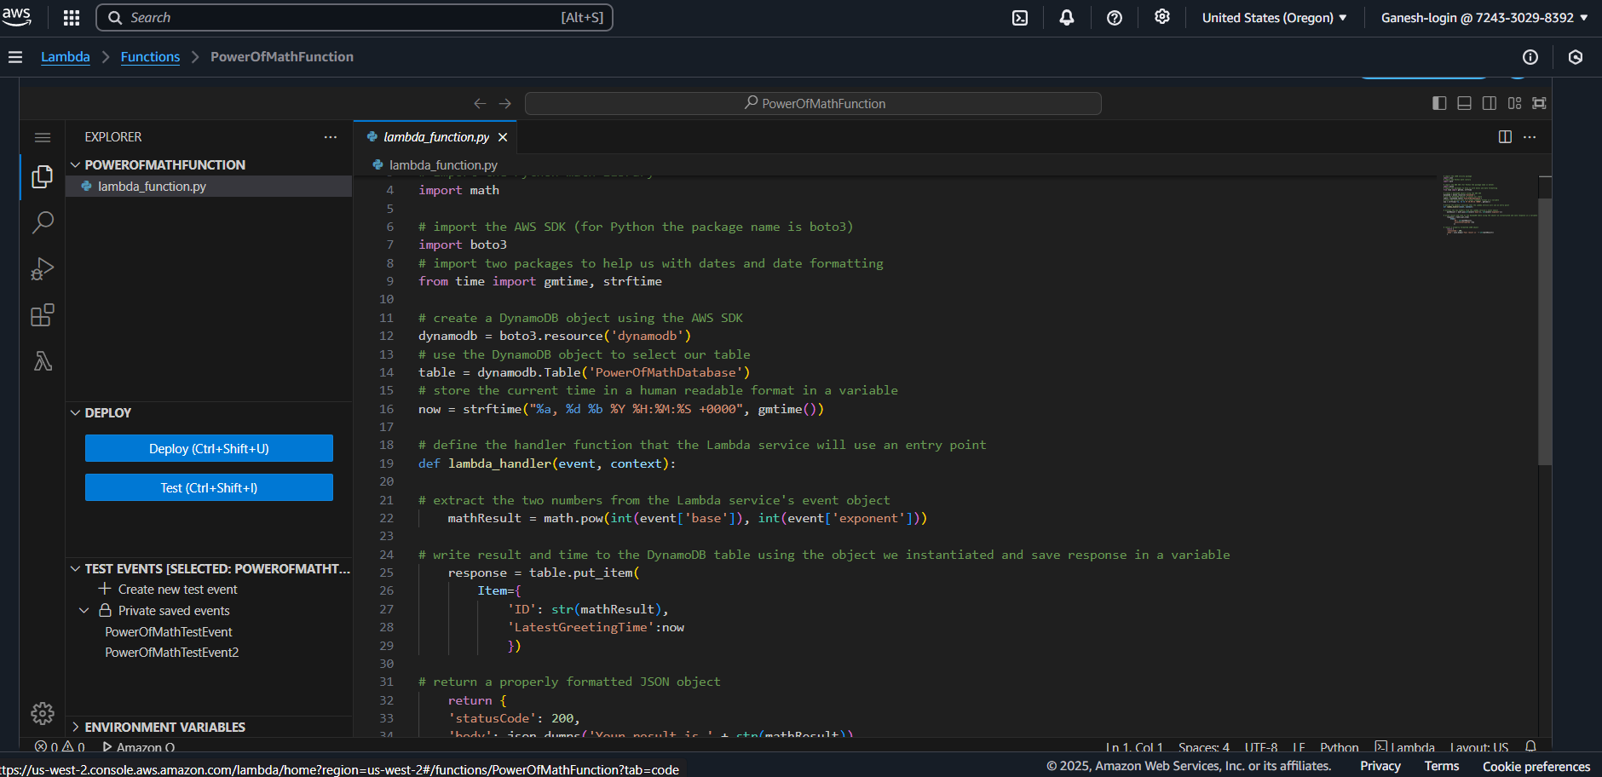
step 2 : Creating and configuring Lambda function
Give Function name, enter PowerofMathfunction.
Select Python 3.9 from the runtime dropdown and leave the rest of the defaults unchanged
3. Under Code source, replace the code in lambda_function.py with the above code.
4. Save by going to the file menu and selecting Save to save the changes.
5. Choose Deploy to deploy the changes.

Slide 7
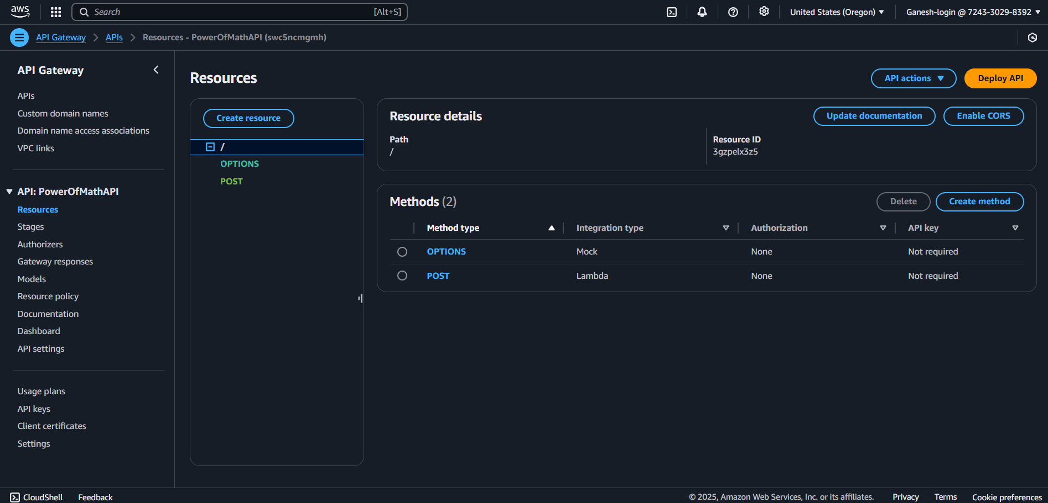
step 3 : Deploying serverless function using Amazon API Gateway
Creating a REST API with API Gateway To make our Lambda function accessible over the internet, we’ll create a RESTful API using AWS API Gateway.
Create api name as ThePowerofMathAPI
Create method as POST and enable CORS

Slide 8
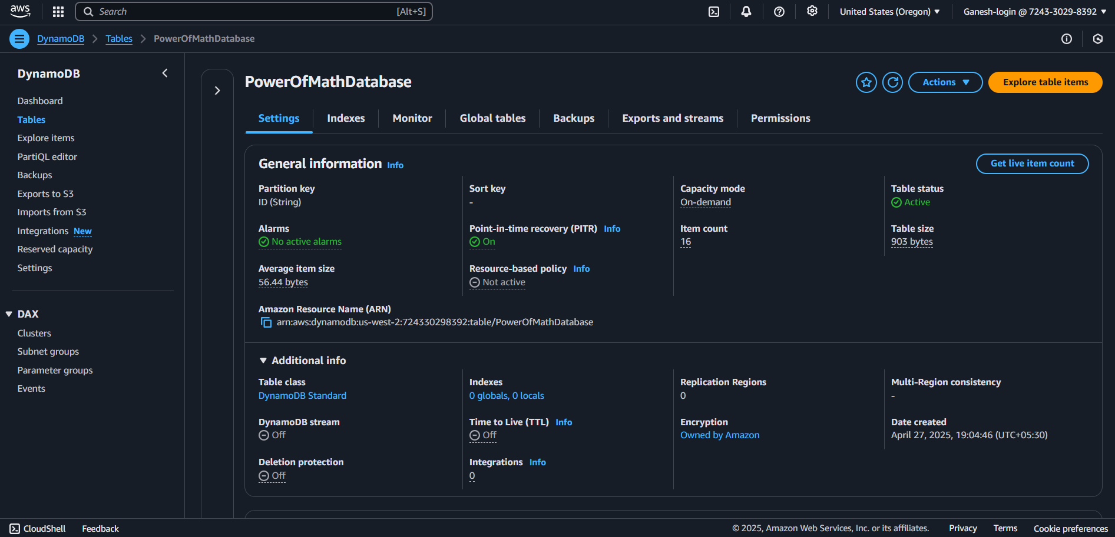
Step 4: Persisting Data to DynamoDB Our web application needs to store math results. We’ll create a DynamoDB table to persist these results securely.
Create Table name, enter PowerofMathDatabase.
In the Partition key field, enter ID. The partition key is part of the table’s primary key.
Leave the rest of the default values unchanged and choose the orange Create table button.
In the list of tables, select the table name, PowerofMathDatabase.
In the General information section, show Additional info by selecting the down arrow and copy and save the Amazon Resource Name (ARN) in a notepad for later use.

Slide 9
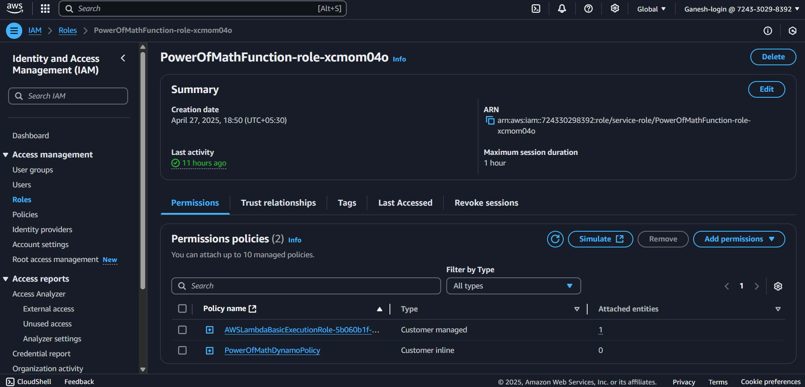
Step 5: Adding IAM policy to Lambda function:
Managing Permissions To ensure security and proper functionality, we’ll grant the Lambda function permission to write to the DynamoDB table.
Fill Policy name then click “Create policy and click on inline policy and paste your JSON code
This policy will allow our Lambda function to read, edit, or delete items, but restrict it to only be able to do so in the table we created

Slide 10
step 6 : Modifying the static website to invoke API and display result based on input.
We should update the static website we created in step1 to invoke the REST API we created in step 3. this will add the ability to display result based on what you input.
Open the index.html file you created in module one.
Make sure you add your API Invoke URL in the HTML code .
Save the file.
ZIP (compress) only the HTML file.
Open the AWS Amplify.
Choose the web app created in step 1.
Choose the white Choose files button.
When the file is uploaded, a deployment process will automatically begin. Once you see a green bar, your deployment will be complete.

Slide 11
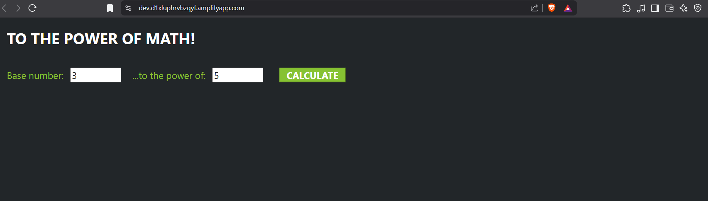
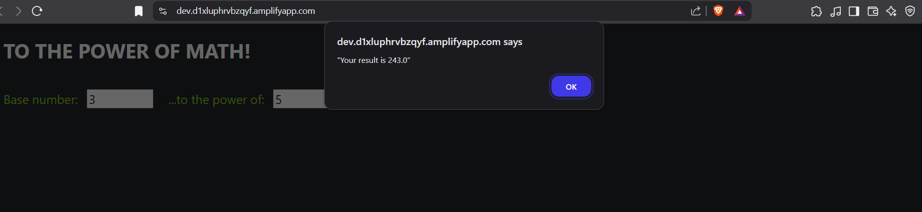
Testing the Updated web app (Output) :
Finally, click on the URL in the domain and a page will open in the browser.
Give the values of any two number in the specified boxes (i.e. base number ,to the power of) and press calculate to see the result in the browser.
Yaay!!Congratulations! Now we have a working web app deployed by Amplify console that can call a Lambda function via API Gateway.

Slide 12
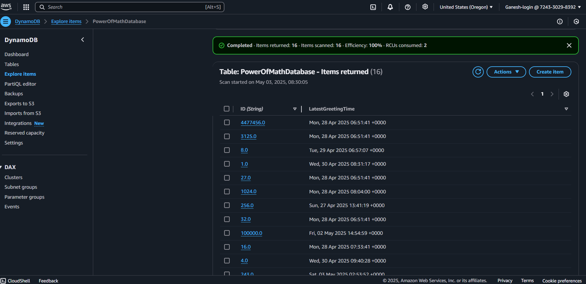
To confirm, you can check database(dynamo db):

Slide 13


